Slide 1


14
Web-Based Applications
C# Programming: From Problem Analysis to Program Design
2nd Edition
C# Programming: From Problem Analysis to Program Design

Slide 2
Chapter Objectives
Discover how Web-based applications differ from Windows applications
Use ASP.NET to create Web applications
Develop and configure Web Forms pages
Learn about different types of controls that can be added to Web applications
Add HTML and Web Forms server controls to Web applications
C# Programming: From Problem Analysis to Program Design

Slide 3
Chapter Objectives (continued)
Add validation, custom, and composite controls to verify user input, display calendars, and connect to database tables
Become aware of Web Services and their implications for distributed applications
Learn how mobile applications are developed using the Compact Framework (optional)
C# Programming: From Problem Analysis to Program Design

Slide 4
Web-Based Applications
Runs within an Internet browser
Collection of one or more related files or components stored on a server
Web server is software that hosts or delivers Web application
Hardware at location where Web server software is loaded is often called a Web server
  It is the software that makes the equipment special and thus enables the computer to be called a server
C# Programming: From Problem Analysis to Program Design

Slide 5
Web Programming Model
MessageBox dialog boxes are not used with Web applications
  Output would be displayed on the server
  Output displayed through Label or other objects on Web page
Each request to view a Web page requires round trip to the server
  Requests page via Hypertext Transfer Protocol (HTTP)
  Page sent back as Hypertext Markup Language (HTML) document
C# Programming: From Problem Analysis to Program Design

Slide 6
Web Programming Model (continued)
Page is rendered – converted from HTML upon return to the browser
Every postback trip to the server creates new object
  Causes Web pages to be stateless
    Pages do not retain their values from one trip to the Web server to the next
C# Programming: From Problem Analysis to Program Design

Slide 7
Static Pages
Client-side application
Provide no interaction with the user
Does not require any processing on the client computer or by a Web server
  Precreated pages residing on the server's hard drive
  Delivered as HTML documents
    HTML file contains formatting markup tags
C# Programming: From Problem Analysis to Program Design

Slide 8
Dynamic Pages
Involve processing in addition to rendering the formatting HTML tags
One programming model is to use traditional or classic Active Server Pages (ASP)
  Includes script code in the HTML file – client-side scripts
  Server-side scripts require processing to be done at the server level before page is delivered
  VBScript and JavaScript – scripting languages
C# Programming: From Problem Analysis to Program Design

Slide 9
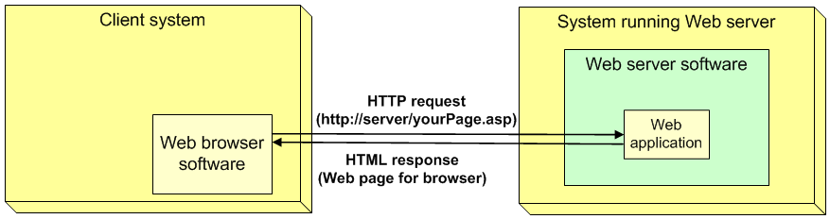
Dynamic Pages (continued)
Figure 14-2 Server-side processing of a dynamic Web page
C# Programming: From Problem Analysis to Program Design

Slide 10
ASP.NET
Newer model for Web development
Does not require writing code in a separate scripting language
Includes a number of classes as part of the .NET Framework
To identify an ASP from an ASP.NET Web application, look at file extensions
  ASP Web page ends with an .asp file extension
  ASP.NET Web page ends with an .aspx file extension
C# Programming: From Problem Analysis to Program Design

Slide 11
ASP.NET (continued)
Two options for developing ASP.NET applications
Use the new ASP.NET Development Server
  Available with Visual Studio 2005 and Visual Web Developer
  Preferred option for developing and testing applications from a directory on a local machine
Second option: use Microsoft Internet Information Services (IIS)
C# Programming: From Problem Analysis to Program Design

Slide 12
Visual Web Developer
New product as part of Express line
  Includes built-in ASP.NET development server
WYSIWYG – drag-and-drop approach to design
Includes features to publish applications
Includes option to create a File-system Web site
  Store and run your Web application in any directory on your local machine
Get same functionality included as part of Visual Studio 2005
C# Programming: From Problem Analysis to Program Design

Slide 13
Web Forms Page
System.Web.UI namespace
  Namespace includes Control class, inherited by the HTMLControl and WebControl classes
  Namespace also includes Page class
Web applications designed with event-driven model, but there are fewer events
  Web Forms page instead of Windows Forms
Build an ASP.NET Web application; two separate files are created
C# Programming: From Problem Analysis to Program Design

Slide 14
Web Forms Page (continued)
Web Forms page file
  Stores visual elements
  Container file from which the controls are displayed
  Contains static HTML tags
Code-behind file
  Where the programming logic resides
  Stores event-handler methods
C# Programming: From Problem Analysis to Program Design

Slide 15
Web Page
File ending in .aspx holds the HTML tags
  View and directly edit the HTML source
  Tags are automatically inserted for head, title, body, form, and div
First two lines in the .aspx markup file are called page directives
  Page directives are delimited with <%@ and %>
    Language is identified and CodeFile name is listed
    AutoEventWireup attribute set to true
      Event handler methods in the class are used
C# Programming: From Problem Analysis to Program Design

Slide 16
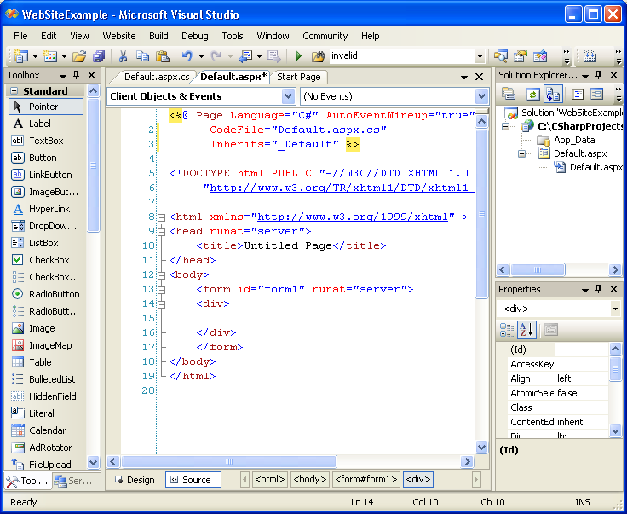
Web Page (continued)
Selected.aspx tab
Figure 14-11 Web Application HTML document
C# Programming: From Problem Analysis to Program Design

Slide 17
Code-Behind File
Initially looks similar to Windows applications, but it is different
No Main( ) method
  Page_Load( ) event handler
Contains many namespaces imported automatically
Can debug and execute Web application from within the IDE
  Default Web browser is launched
C# Programming: From Problem Analysis to Program Design

Slide 18
Code-Behind File (continued)
Auto-generated code not created for ASP.NET 2.0 applications until you run the application
  No hidden .designer.cs file as with Windows apps
Default.aspx created and automatically opened in Source view when you first start building a Web site
App_Data folder is automatically created
  Reserved for storing data files
C# Programming: From Problem Analysis to Program Design

Slide 19
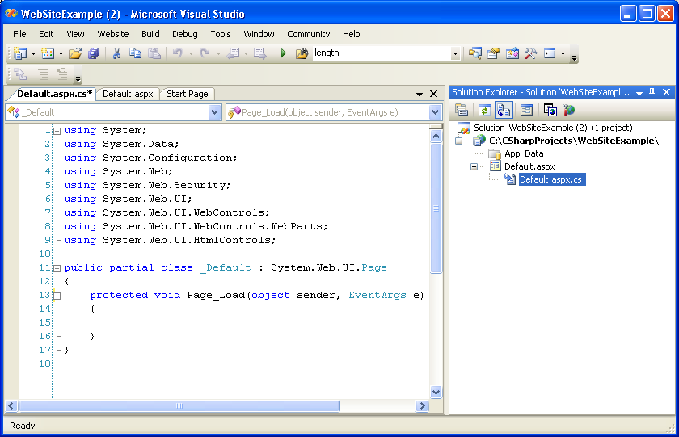
Code-Behind File (continued)
Selected.aspx.cs tab
Figure 14-12 Code-behind file
C# Programming: From Problem Analysis to Program Design

Slide 20
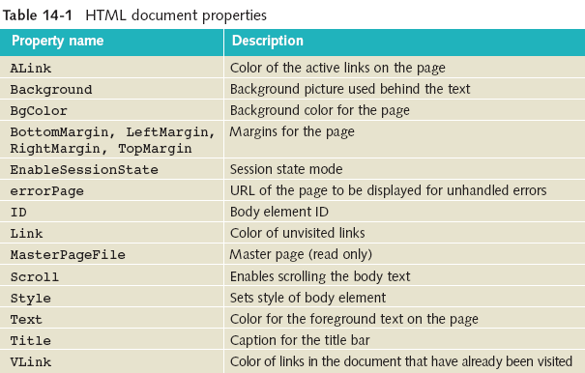
HTML Document File
Page object properties – fewer (and named differently) than available Windows
Form object
C# Programming: From Problem Analysis to Program Design

Slide 21
Controls
HTML
HTML server
WebParts
Validation
Navigation
Login
Data
Crystal Reports
C# Programming: From Problem Analysis to Program Design

Slide 22
Controls (continued)
Beginning with Visual Studio 2005, see Toolbox controls in both Design and Source mode
  Drag and drop controls onto the .aspx Source (HTML) markup page as easily as you drop it on Design page
Several different types of controls available in Toolbox
Most Web Forms controls you will be using are stored under the Standard node on the Toolbox
C# Programming: From Problem Analysis to Program Design

Slide 23
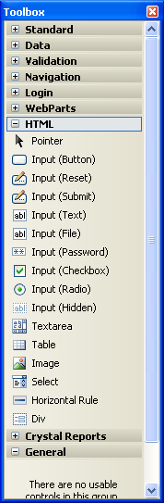
HTML Controls
Client side controls
Can be added to your page using a WYSIWYG drag-and-drop approach
Limited number of HTML controls – even fewer with Visual Studio 2005
Figure 14-14 HTML controls
C# Programming: From Problem Analysis to Program Design

Slide 24
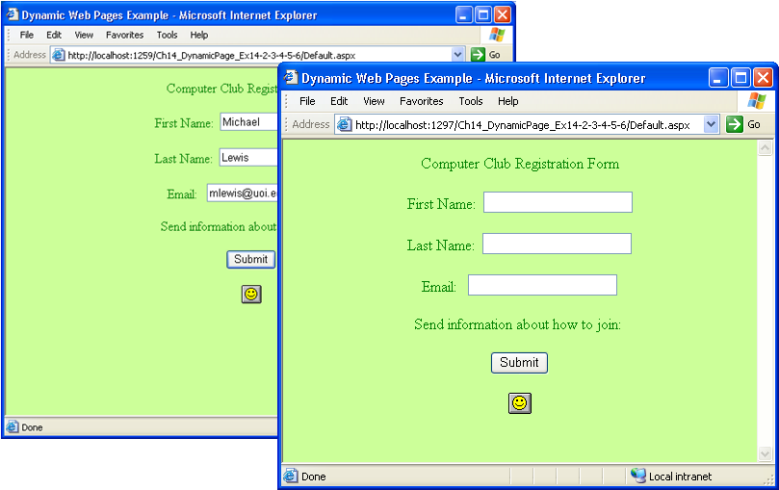
HTML Controls (continued)
HTML controls do not maintain state
Values in text boxes lost when Submit clicked
Figure 14-15 Submit button clicked
C# Programming: From Problem Analysis to Program Design

Slide 25
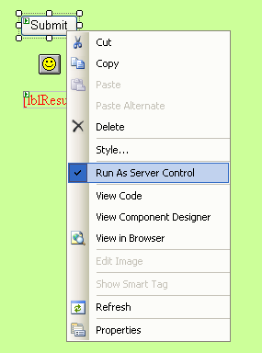
Running HTML Controls as Server Controls
Right-click on the HTML control
Appends runat="server“ to the HTML tag of the control
Figure 14-16 Converting an HTML control to HTML server control
C# Programming: From Problem Analysis to Program Design

Slide 26
Server Control Events
private void btnSubmit_ServerClick(object sender, EventArgs e)
{
this.lblResult.Text = "Thanks!! " +
this.txtFirst.Value + " " +
this.txtLast.Value +
" Information will be forwarded to: " +
this.txtEmail.Value;
}
Text property used with Label
Value property used with Text Field
C# Programming: From Problem Analysis to Program Design

Slide 27
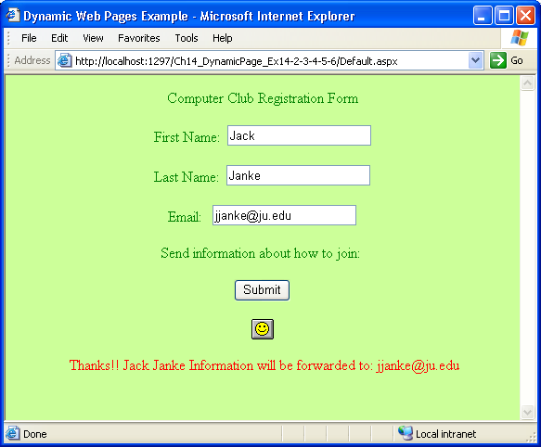
Server Control Events (continued)
Number in address bar following localhost (as the port number) is a relatively random number, placed there when you specify the Location as File System
Figure 14-17 Web page after postback
C# Programming: From Problem Analysis to Program Design

Slide 28
Web Forms Server Controls
Can mix and match HTML and Standard controls on your page
Web Forms Server Controls referred to as Standard controls
  Also referred to as Web Server controls, Web controls, ASP server controls, or simply Web Forms controls
C# Programming: From Problem Analysis to Program Design

Slide 29
Web Forms Server Controls (continued)
Standard Controls have more built-in features than HTML controls
  Look and act like their Windows counterparts (Fewer controls & fewer events to program)
  Use object-oriented model
Web Forms controls do not map straight to HTML
  Often it may take several HTML tags to represent one Web Forms control
C# Programming: From Problem Analysis to Program Design

Slide 30
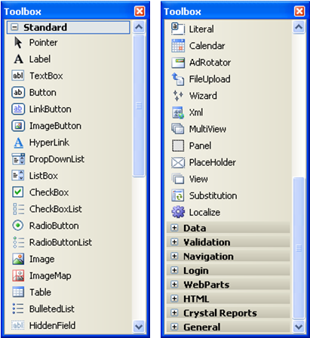
Web Forms Server Controls (continued)
Figure 14-18 Web Forms server standard controls
C# Programming: From Problem Analysis to Program Design

Slide 31
Web Forms Server Controls (continued)
Visual Studio prefixes the control name with <asp:control and ends the tag with /asp:control>
  Also runat= "server " appended
    <asp:control attributes runat="server " /asp:control>
Stored in HTML document – file ending with .aspx extension
C# Programming: From Problem Analysis to Program Design

Slide 32
Web Forms Server Controls (continued)
Fewer properties found with Web Forms types of controls than you find with their Windows Forms counterparts
Control’s properties, like Windows apps, can be set using the Properties window in Visual Studio
  Settings (visual) are stored in the HTML document – the file ending with the .aspx extension
C# Programming: From Problem Analysis to Program Design

Slide 33
Events and Controls
Comparison of Windows Forms button with Web Forms Standard button control object
  Windows Forms button control: 50 properties
  Web Forms Standard button control: 26 properties
  Web Forms Standard button control: 8 events
  Windows Forms button: 58 events
C# Programming: From Problem Analysis to Program Design

Slide 34
Web Forms Server Controls Events
By default, only a few events trigger postback to the server
  Buttons click, events do
  Changes in selections to ListBox, RadioButton, RadioButtonList, CheckBox, CheckBoxList, and DropDownList do not
    AutoPostBack property can be set to true to automatically trigger a postback to the server
    Be judicious with changes to AutoPostBack property
C# Programming: From Problem Analysis to Program Design

Slide 35
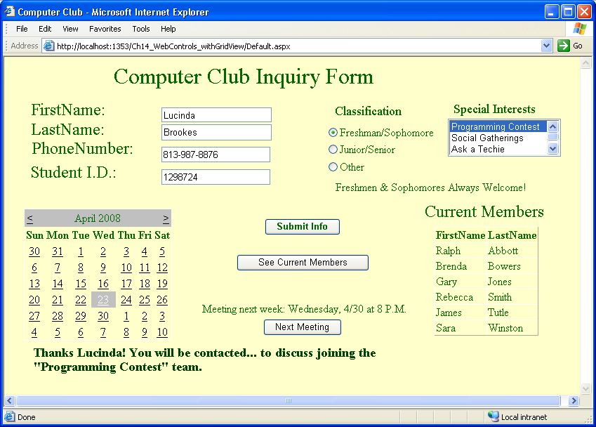
Label, Button, RadioButton, ListBox Objects
Figure 14-20 Web site after adding server controls
C# Programming: From Problem Analysis to Program Design

Slide 36
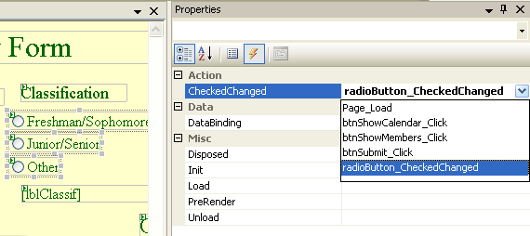
Wiring Event-Handler Methods
All three radio buttons wired to the same event-handler method
Figure 14-21 Wiring the same event
to three RadioButton objects
C# Programming: From Problem Analysis to Program Design

Slide 37
RadioButton Event-Handler Method
private void radioButton_CheckedChanged(object sender,
System.EventArgs e)
{
if (this.radBtnFresSop.Checked)
{
this.lblClassif.Text = "Freshmen & Sophomores ";
}
else if (this.radBtnJrSr.Checked)
{
// More statements
C# Programming: From Problem Analysis to Program Design

Slide 38
Button Event-Handler Method (continued)
private void btnSubmit_Click(object sender, System.EventArgs e)
{
this.lblSubmit.Text = "Thanks " + this.txtBxFname.Text +
"! You will be contacted... ";
if (lstBxInterests.SelectedIndex > -1)
{
this.lblSubmit.Text += " to discuss joining" +
" the \"" + this.lstBxInterests.SelectedItem.Text + "\" team.";
}
}
Retrieve from TextBox and selections from ListBox
Retrieve values from TextBox and selections from ListBox
C# Programming: From Problem Analysis to Program Design

Slide 39
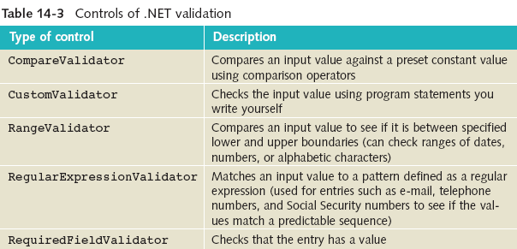
Validation, Custom, and Composite Controls
C# Programming: From Problem Analysis to Program Design

Slide 40
Validation Controls
Treat validation control objects like any other control
Properties
  ControlToValidate
    Tie the validation control to a specific form control object
  ErrorMessage
    Set to the message you want displayed when the input control does not pass the validation
C# Programming: From Problem Analysis to Program Design

Slide 41
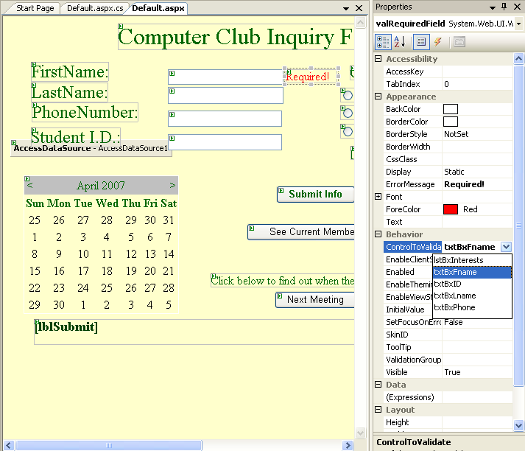
Validation Controls (continued)
RequiredField-Validator control is placed beside the object it is validating
Figure 14-22 Adding a RequiredFieldValidator control
C# Programming: From Problem Analysis to Program Design

Slide 42
Page Validation
Every control field on the page that has an associated validation control is checked when the page is posted
CausesValidation property of Button(s) can be set to false
  By default, every Button object's CausesValidation property is set to true
C# Programming: From Problem Analysis to Program Design

Slide 43
Calendar Control
Display calendar months on a Web page
  Calendar is live
  Can view and select dates
Properties
  SelectedDate
    Used to pick the month, day, and year for display
    Initially set to the current date; date can be set programmatically
  Customize with gridlines, borders; change font, background, foreground colors; set cell padding and spacing
C# Programming: From Problem Analysis to Program Design

Slide 44
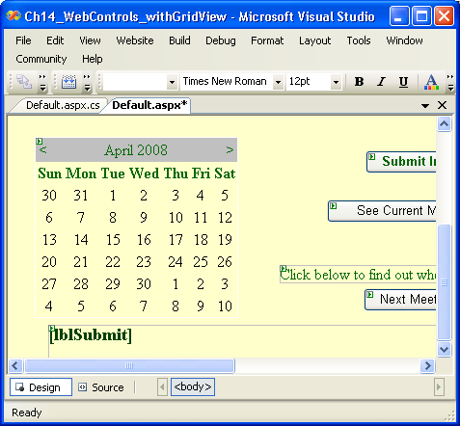
Calendar Control (continued)
Click here to view
“code behind” file
Current selection (.aspx file)
Click here to view
HTML tags
Use Page_Load( ) event-handler method to set the date with program statements
Current design view
Figure 12-24 Switching between .aspx and .aspx.cs files
C# Programming: From Problem Analysis to Program Design

Slide 45
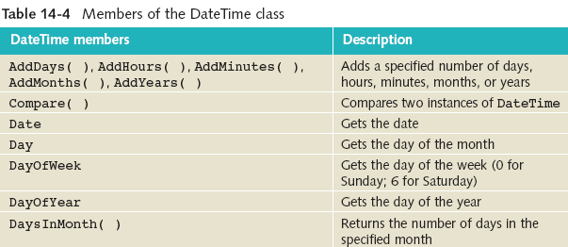
Calendar Control (continued)
C# Programming: From Problem Analysis to Program Design

Slide 46
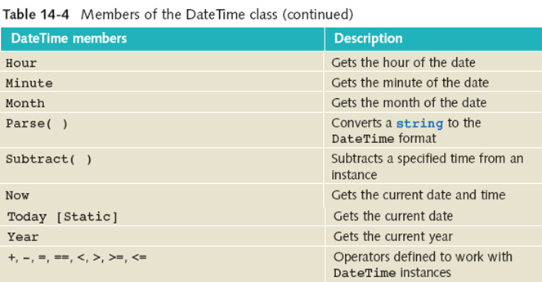
Calendar Control (continued)
C# Programming: From Problem Analysis to Program Design

Slide 47
Using a Calendar Control in Applications
private void btnShowCalendar_Click(object sender, System.EventArgs e)
{
Calendar1.SelectedDates.Clear( );
meetingDate = new DateTime (DateTime.Today.Year,
DateTime.Today.Month, DateTime.Today.Day, 8,0,0);
meetingDate = meetingDate.AddDays(7);
if (meetingDate.DayOfWeek.ToString() == "Sunday")
{
meetingDate = meetingDate.AddDays(1);
}
C# Programming: From Problem Analysis to Program Design

Slide 48
Using a Calendar Control in Applications (continued)
    Calendar1.SelectedDate = meetingDate;
    this.lblMsg.Text = ("Meeting " + "next week: " + meetingDate.DayOfWeek +
    ", " + meetingDate.Month +
    "/" + meetingDate.Day +
    " at " + meetingDate.Hour +
    " P.M.");
  } // end of btnShowCalendar_Click ( ) method
C# Programming: From Problem Analysis to Program Design

Slide 49
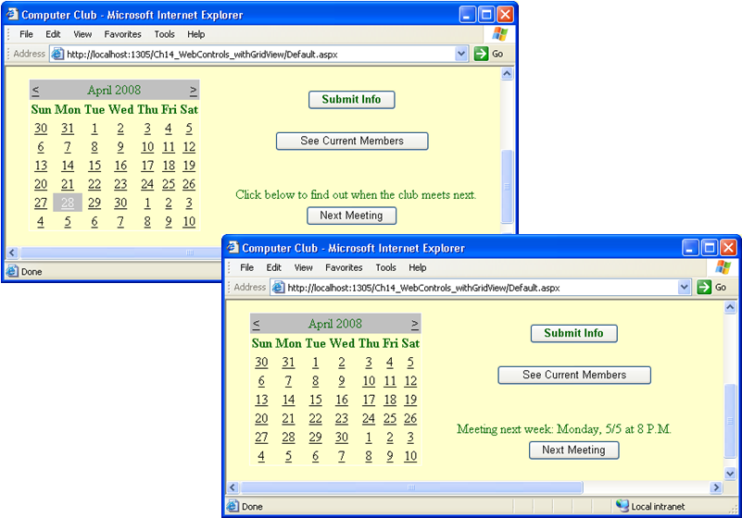
Calendar Control (continued)
Displayed date
Figure 14-26 Calendar showing different dates selected
C# Programming: From Problem Analysis to Program Design

Slide 50
DataGrid and GridView Controls
Display data in a tabular format
Can bind data to a data source, such as a database
Common data source classes used to bind DataGrid objects to the actual data
  DataReader
  DataSet
C# Programming: From Problem Analysis to Program Design

Slide 51
Using a DataGrid Control in Applications
Use OleDB Data Provider for Access database
  Connection string identifies the provider as an Access database and specifies the name of the database
Follow same guidelines/steps used to connect to database using Windows application
  Minor change needed for Web application
    DataBind( ) method call is different for Web applications
C# Programming: From Problem Analysis to Program Design

Slide 52
WebControls Application – Database Access
private void btnShowMembers_Click(object sender, System.EventArgs e)
{
lblMembers.Visible = true;
try
{ string sConnection = "Provider=
Microsoft.Jet.OLEDB.4.0;" + "Data Source=" +
"C:\\CSharpProjects\\WebControls\\member.mdb";
OleDbConnection dbConn = new OleDbConnection(sConnection);
string sql = "Select FirstName, LastName From memberTable " +
" Order By LastName Asc, FirstName Asc;";
C# Programming: From Problem Analysis to Program Design

Slide 53
OleDbCommand dbCmd = new OleDbCommand( );
dbCmd.CommandText = sql;
dbCmd.Connection = dbConn;
OleDbDataAdapter memberDataAdap = new
OleDbDataAdapter( );
memberDataAdap.SelectCommand = dbCmd;
memberDS = new DataSet( );
// DataSet declared as protected class member
memberDataAdap.Fill(memberDS, "memberTable");
// Binding is only change needed from the Windows app
this.dataGrid1.DataBind( );
}
// Catch clause goes here
C# Programming: From Problem Analysis to Program Design

Slide 54
AccessDataSource
Can use the data visual configuration tools and have these statements automatically generated for you
  Instead of writing the program statements
.NET 2.0 includes two new data source classes
  These classes reduce the need for accessing individual Data Provider classes
    AccessDataSource and SqlDataSource
      All providers (SQL Server, Oracle, ODBC, and OLEDB) can use SqlDataSource.
C# Programming: From Problem Analysis to Program Design

Slide 55
AccessDataSource (continued)
AccessDataSource inherits from the SqlDataSource
Use SQL queries to perform data retrieval
Includes large number of properties and methods
Do not have to set the Connection String property
  Just identify the location of the Access .mdb file using the DataFile property
  Can provide relative path to the data base
Use visual configuration tools to connect
C# Programming: From Problem Analysis to Program Design

Slide 56
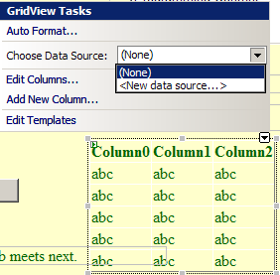
Use Visual Tools to Connect
New Data Source
GridView object dragged to form
Smart tag
Figure 14-27 Binding data source to the GridView
C# Programming: From Problem Analysis to Program Design

Slide 57
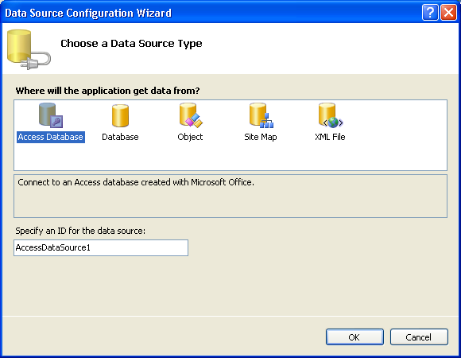
Use Visual Tools to Connect (continued)
Figure 14-28 Connecting to Access database
C# Programming: From Problem Analysis to Program Design

Slide 58
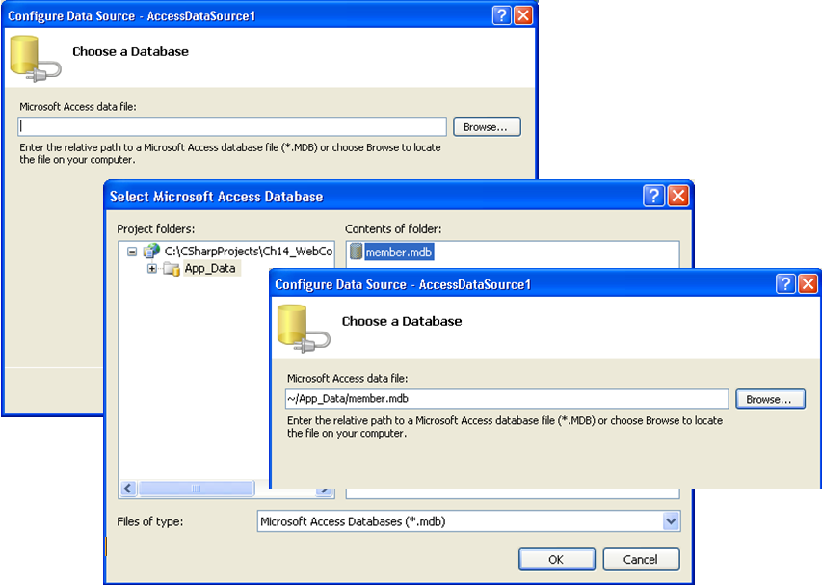
Use Visual Tools to Connect (continued)
Place database in the reserved App_Data directory
Figure 14-29 Relative address for the Access database
C# Programming: From Problem Analysis to Program Design

Slide 59
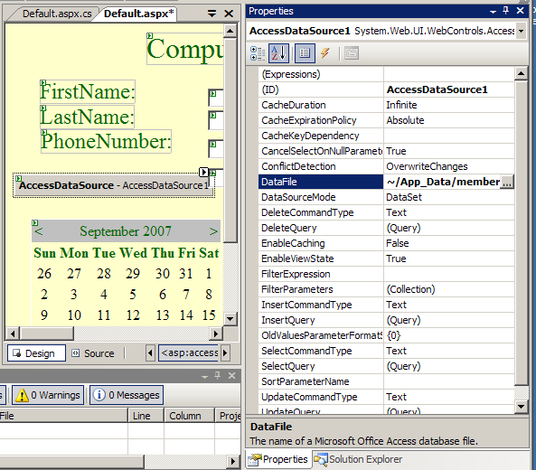
Use Visual Tools to Connect (continued)
Figure 14-30 AccessDataSource Object
C# Programming: From Problem Analysis to Program Design

Slide 60
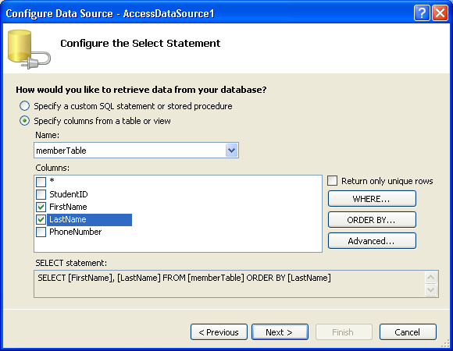
Use Visual Tools to Connect (continued)
Figure 14-31 Identify what data to retrieve
C# Programming: From Problem Analysis to Program Design

Slide 61
Modifying the Data
By default, DataGrid control displays data in read-only format
To allow users to edit data, use Advanced tab from the Data Source Configuration tool to configure the select statement
  This generates the additional Insert, Delete, and Update SQL statements
    All primary key values must be retrieved as part of the select statement
      Key columns can be removed using the smart tag once the configuration is complete
C# Programming: From Problem Analysis to Program Design

Slide 62
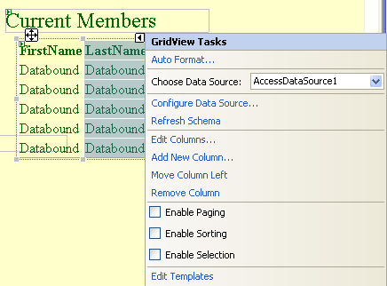
Use Visual Tools to Connect (continued)
Figure 14-32 GridView tasks
C# Programming: From Problem Analysis to Program Design

Slide 63
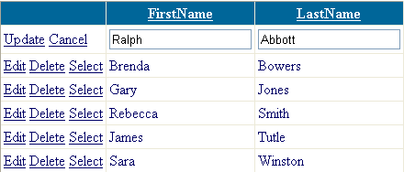
Use Visual Tools to Connect (continued)
When application runs, columns display Edit and Delete
  Clicking the Edit button causes the row of data to be displayed in an editable format
Figure 14-33 Modifying data table
C# Programming: From Problem Analysis to Program Design

Slide 64
Other Controls
Navigation
  Can now add site navigation by defining a site map
  TreeView and SiteMapPath controls
Master Pages
  Consistent layout for multiple-page
  Create content pages that are displayed using the master page as the template
Data
  New with 2.0 are DetailsView and FormView controls
C# Programming: From Problem Analysis to Program Design

Slide 65
Other Controls (continued)
Login
  New security controls that enable you to authenticate users
  PasswordRecovery control helps users change or remember passwords
  LoginStatus control lets you present a Login or Logout button
C# Programming: From Problem Analysis to Program Design

Slide 66
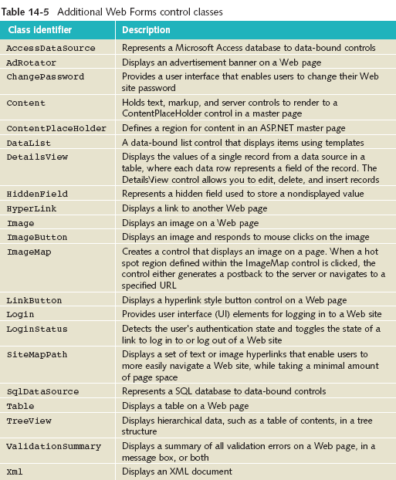
C# Programming: From Problem Analysis to Program Design

Slide 67
Transport ASP.NET Application from One Web Server to Another
On destination computer (that has IIS installed), create ASP.NET project or ASP.NET Web Service project
  Use EXACTLY the same name as original
Close the project and close Visual Studio
Using MyComputer or Windows Explorer, copy original files from the original target folder into C:\Inetpub\wwwroot\projectName subdirectory
  During copy, when prompted about replacing existing files, select “Yes to All”
C# Programming: From Problem Analysis to Program Design

Slide 68
Web Services
Enable exchange of data from one computer to another, over the Internet or an intranet
  Applications that return data
  Does not involve presentation layer
Uses standard protocols
  Hypertext Transfer Protocol (HTTP)
  Extensible Markup Language (XML)
  Simple Object Access Protocol (SOAP)
  Web Services Description Language (WSDL)
C# Programming: From Problem Analysis to Program Design

Slide 69
Web Services (continued)
Messages are sent as XML from one method to another
  Data is physically returned as part of an XML message
XML uses tags to provide format for describing data like HTML
  HTML tags tell browser how to display data in different formats
  XML is readable
  XML uses tags to describe the data being exchanged
C# Programming: From Problem Analysis to Program Design

Slide 70
Chapter Summary
Web site
  Static versus dynamic pages
Protocols
  HTML, HTTP, XHTML
ASP.NET
Web Forms page
  Creating Web page
C# Programming: From Problem Analysis to Program Design

Slide 71
Chapter Summary
Web-based versus Windows applications
Controls
  HTML, HTML server, Standard controls
    Validation, navigation, login, data
    Calendar
Connect to database tables
  Programmatically
  Use visual configuration tools
C# Programming: From Problem Analysis to Program Design

